Slide 1
33 Practice Citing Sources (Answers)-28_eng_rw_v4.pptx
Here are the answers to the 32 Practice Citing Sources (Blank)-28_eng_rw_v6.pptx file.
¹ Note
⁵ Repeat
Bibliography

Slide 2
1: Book with One Author (WS 5.1)
¹ Ben Witherington III, The Gospel Code: Novel Claims About Jesus, Mary Magdalene and Da Vinci (Downers Grove, IL: IVP, 2004), 129.
⁵ Witherington, The Gospel Code, 129.
Witherington, Ben, III. The Gospel Code: Novel Claims About Jesus, Mary Magdalene and Da Vinci. Downers Grove, IL: IVP, 2004.
Notes:
Note that the “III” has no comma before it in the footnote, but it does has a comma in the Bibliography. It also ties to his given name rather than to his family name since he is the third generation to be called “Ben” but not the third “Witherington.”

Slide 3
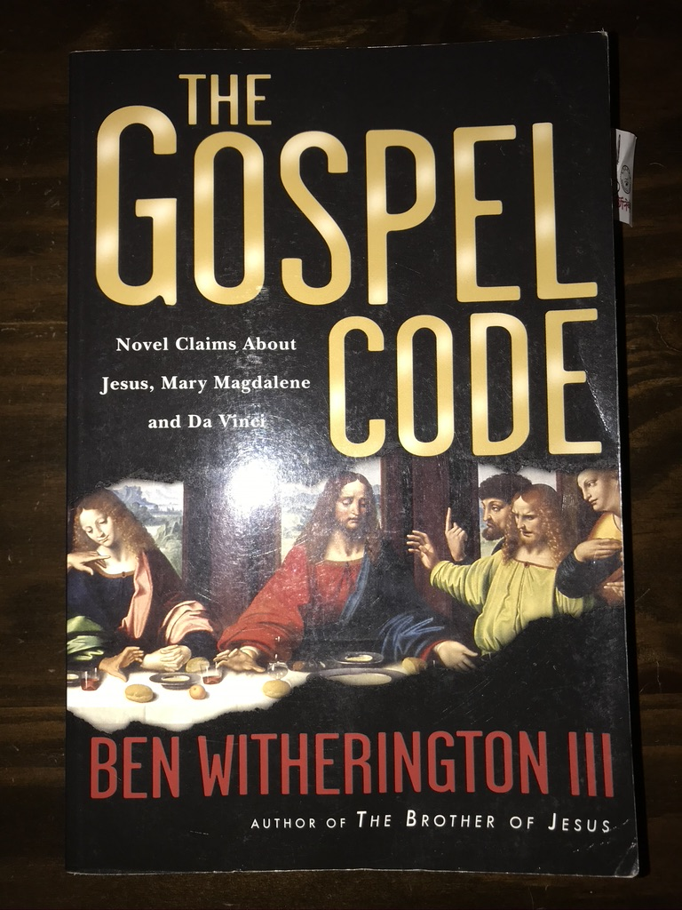
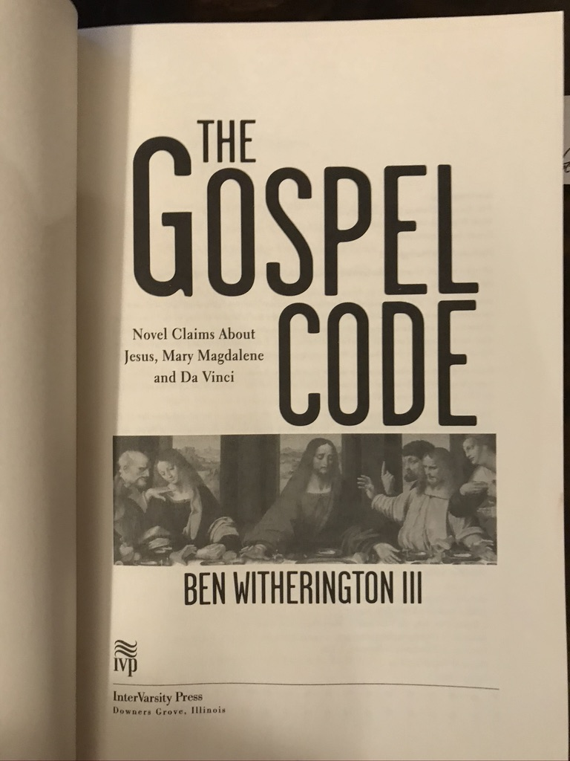

Slide 4
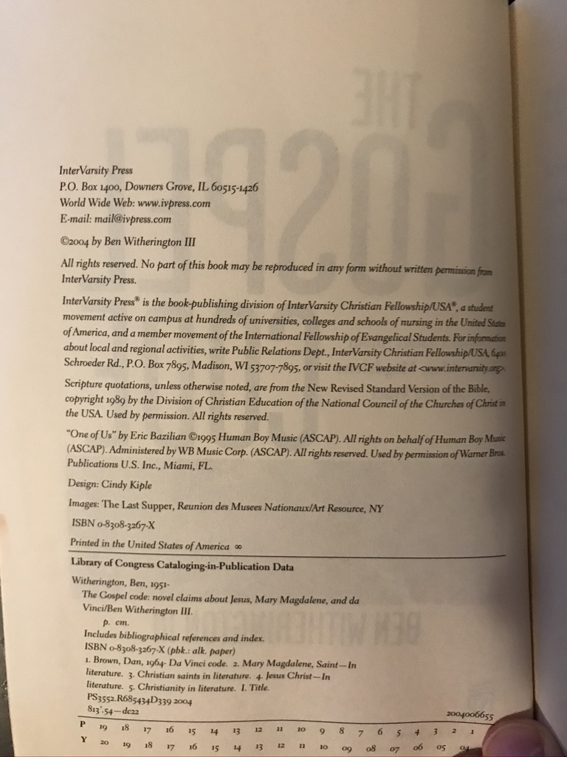
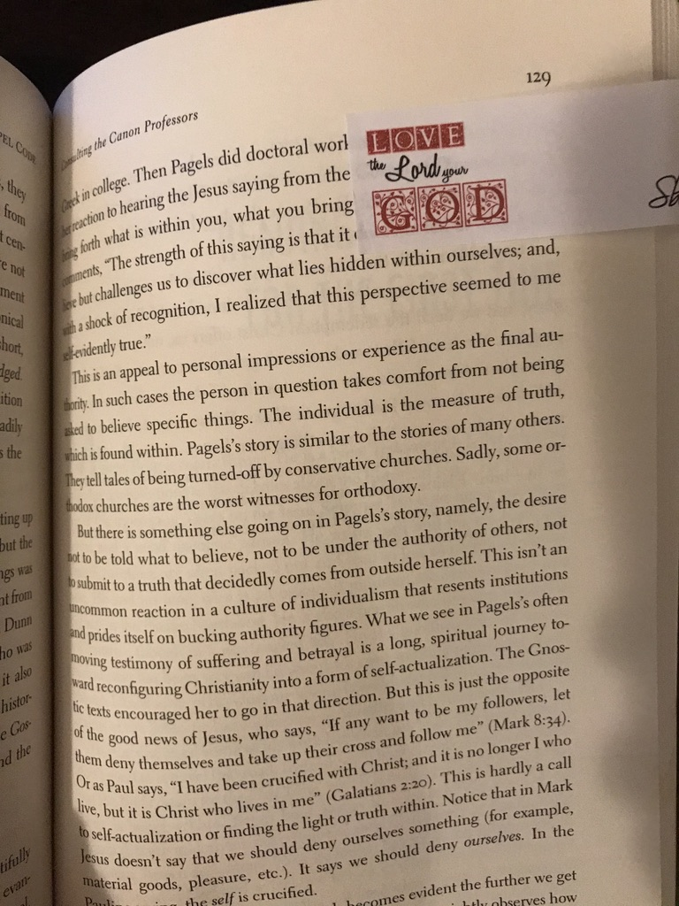

Slide 5
2: Book with Two Authors (WS 5.2)
¹ Craig Ott and Gene Wilson, Global Church Planting: Biblical Principles and Best Practices for Multiplication (Grand Rapids, MI: Baker, 2011), 231.
⁵ Ott and Wilson, Global Church Planting, 231.
Ott, Craig, and Gene Wilson. Global Church Planting: Biblical Principles and Best Practices for Multiplication. Grand Rapids, MI: Baker, 2011.

Slide 6

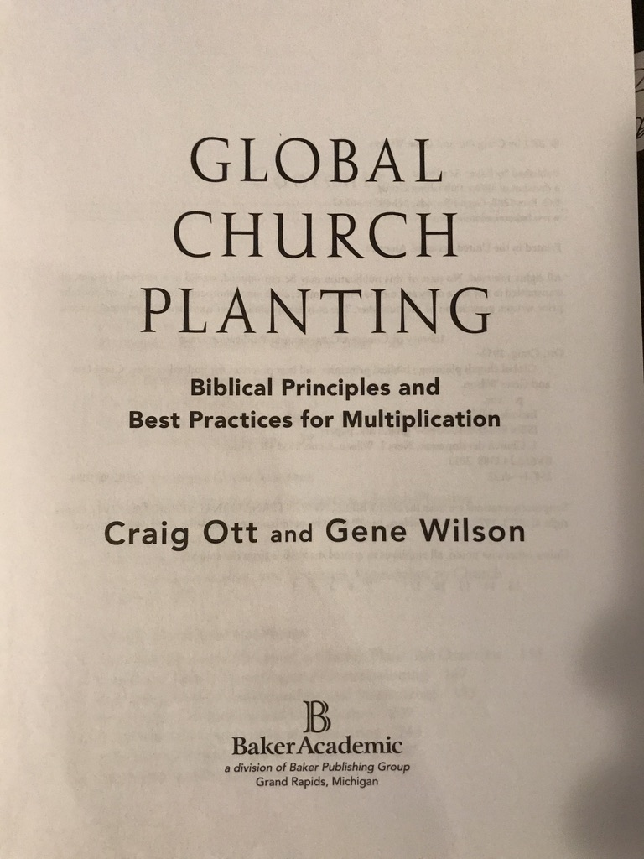

Slide 7
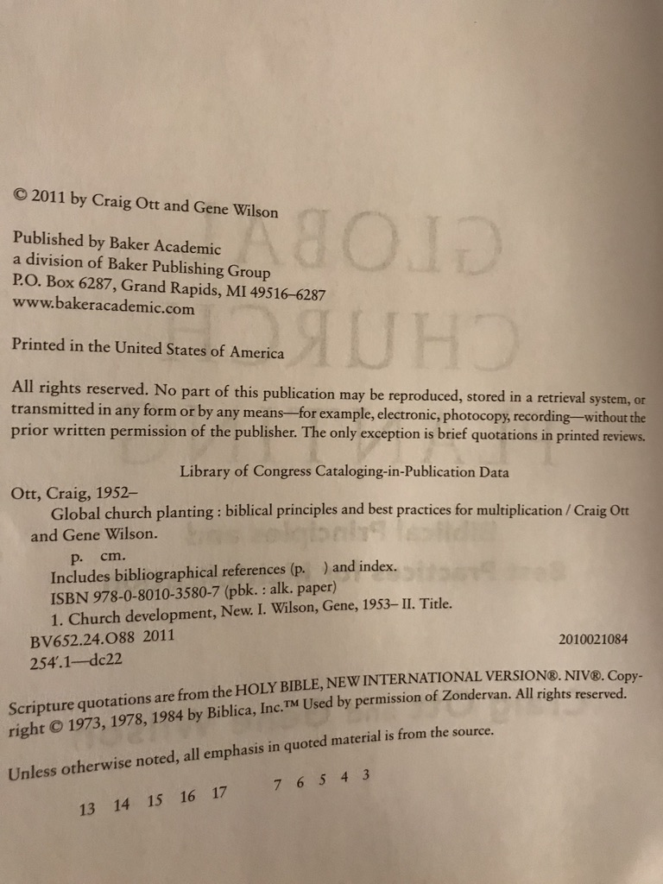
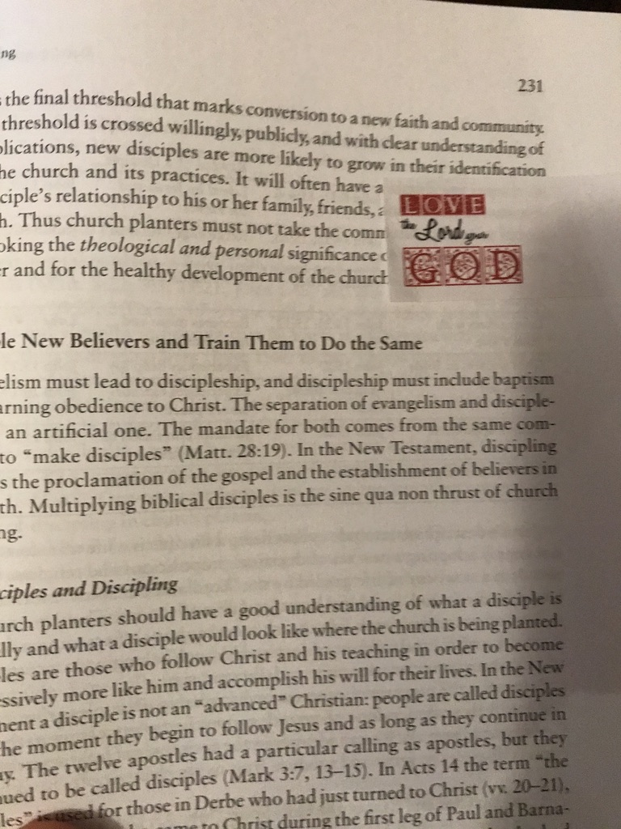

Slide 8
3: Book with Author & Editor (WS 5.14)
¹ James K. Hoffmeier, “Egyptians,” in Peoples of the Old Testament World, eds. Alfred J. Hoerth, Gerald L. Mattingly and Edwin M. Yamauchi (Grand Rapids, MI: Baker, 1994), 265.
⁵ Hoffmeier, “Egyptians,” 265.
Hoffmeier, James K. “Egyptians.” In Peoples of the Old Testament World. Eds. Alfred J. Hoerth, Gerald L. Mattingly and Edwin M. Yamauchi. Grand Rapids, MI: Baker, 1994.

Slide 9
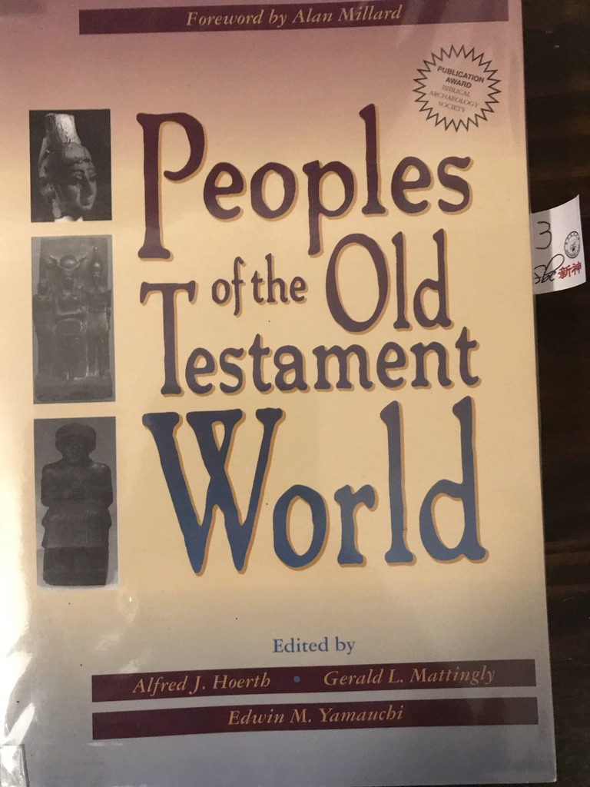
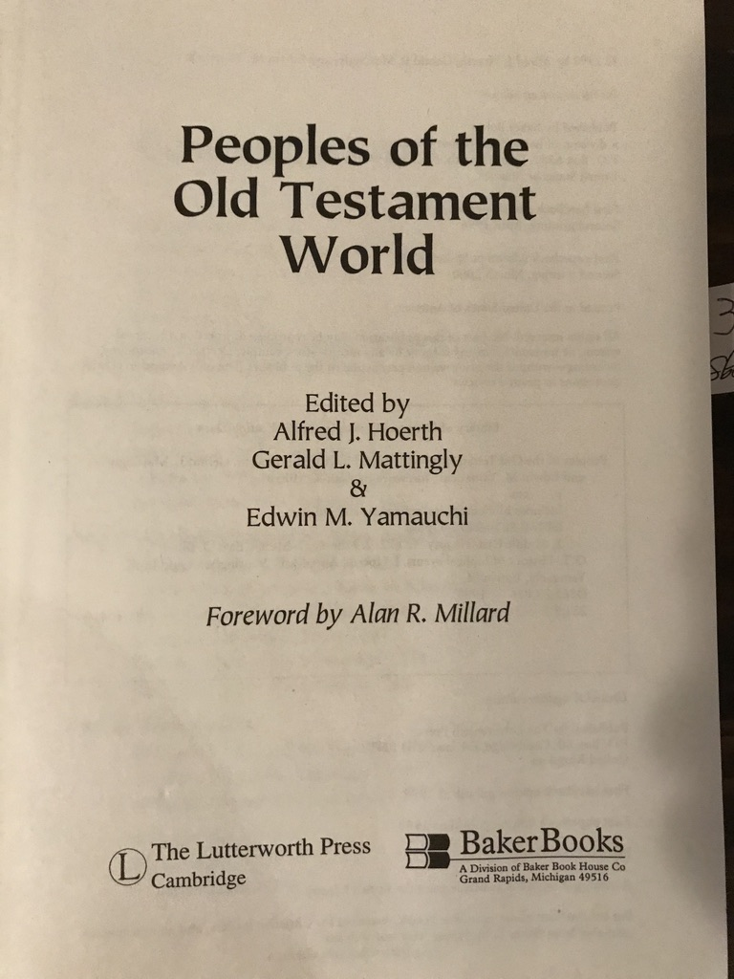

Slide 10
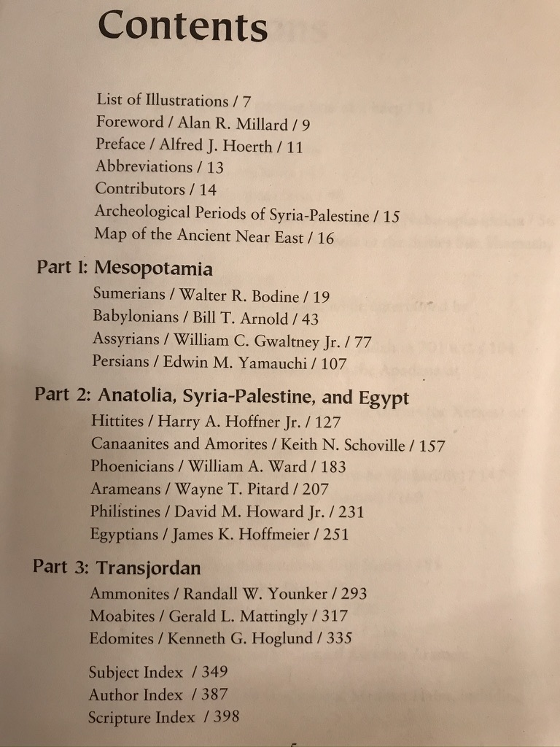
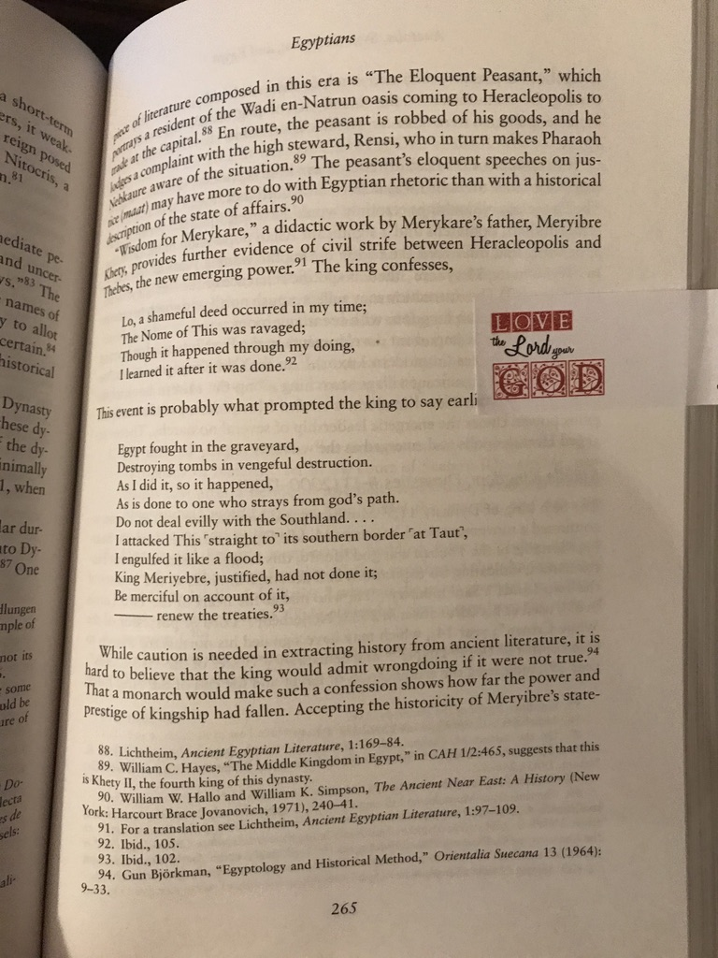

Slide 11
4: Book of Primary Sources (WS 5.36)
¹Philo, On Husbandry 8.36-38 (Elwell and Yarbrough, Readings from the First-Century World, 189).
⁵Philo, On Husbandry 8.36-38.
Philo. Readings from the First-Century World. Eds. Walter A. Elwell and Robert W. Yarbrough. Grand Rapids, MI: Baker, 1998.

Slide 12
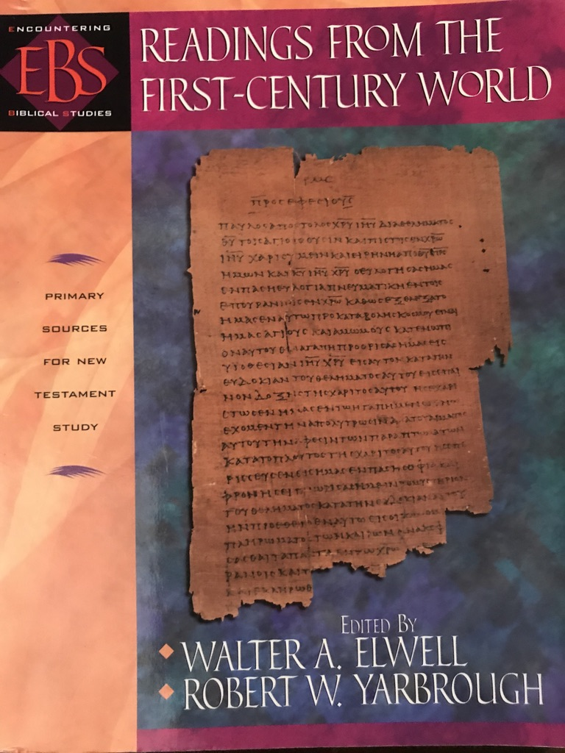
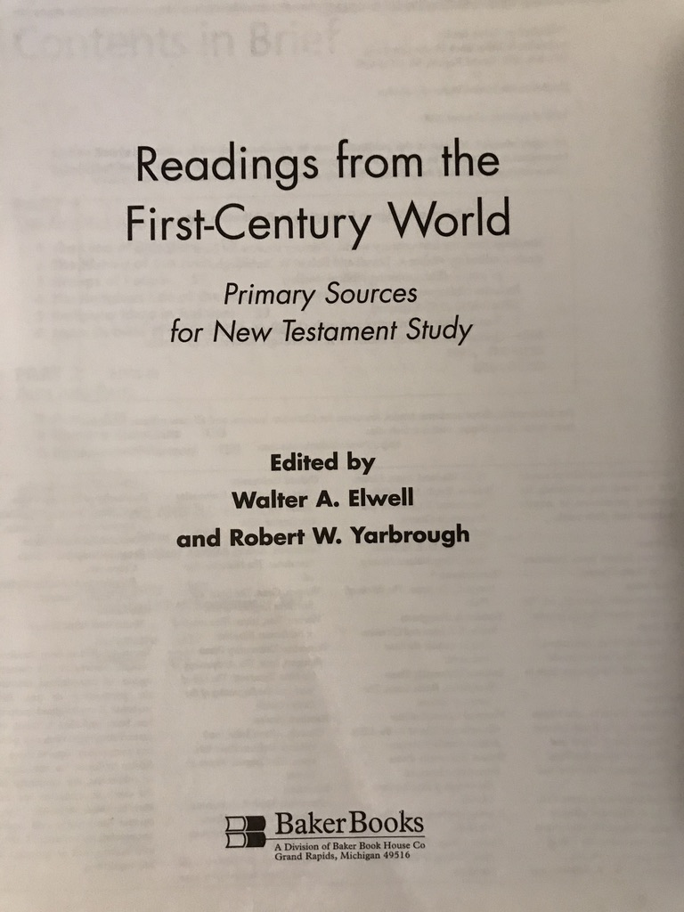

Slide 13
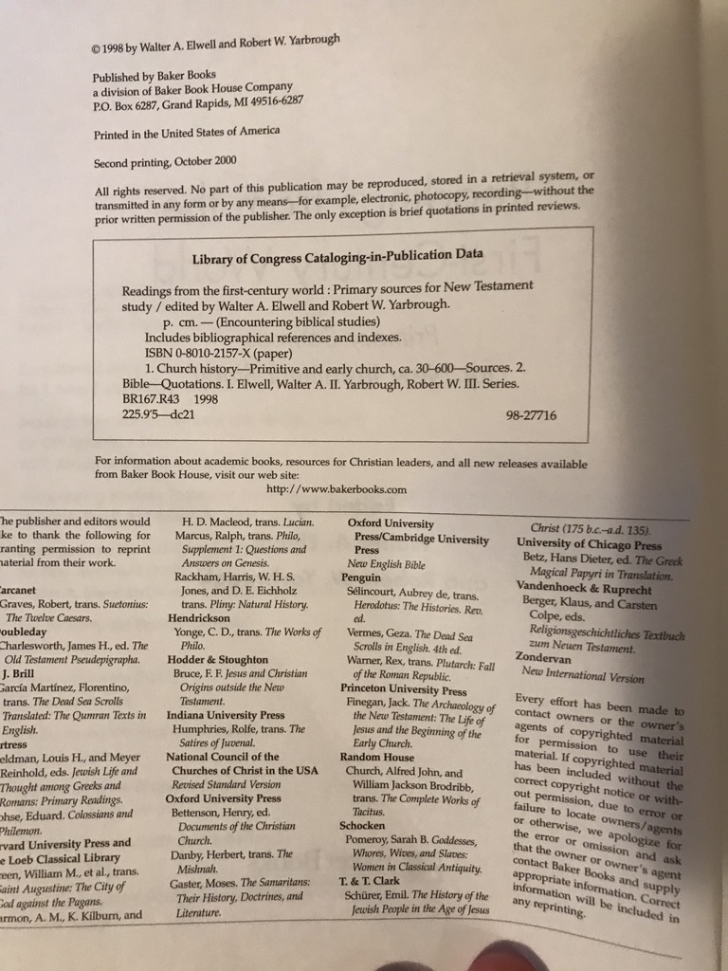
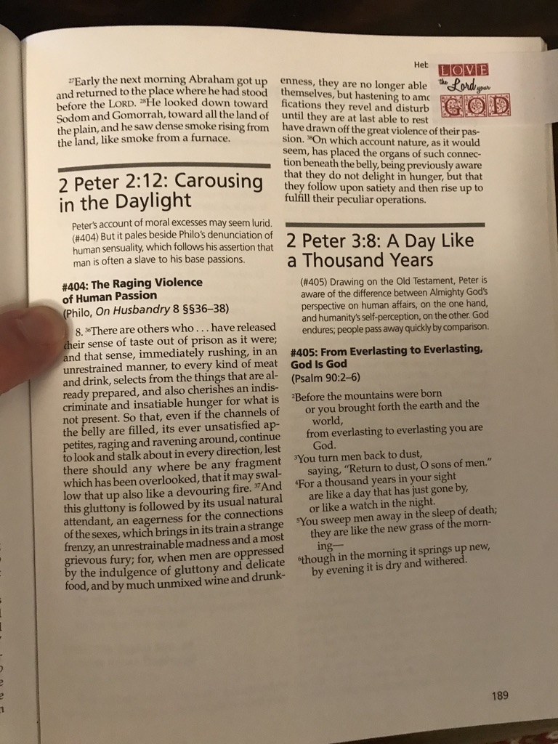

Slide 14
5: Greek Lexicon with BibleWorks Greek Font (WS 5.24)
¹ "poiki,loj," BDAG 683.
⁵ BDAG 683.
Bauer, W., F. W. Danker, W. F. Arndt, and F. W. Gingrich. A Greek-English Lexicon of the New Testament and Other Early Christian Literature. 2d ed. Chicago: University of Chicago Press, 1979.

Slide 15
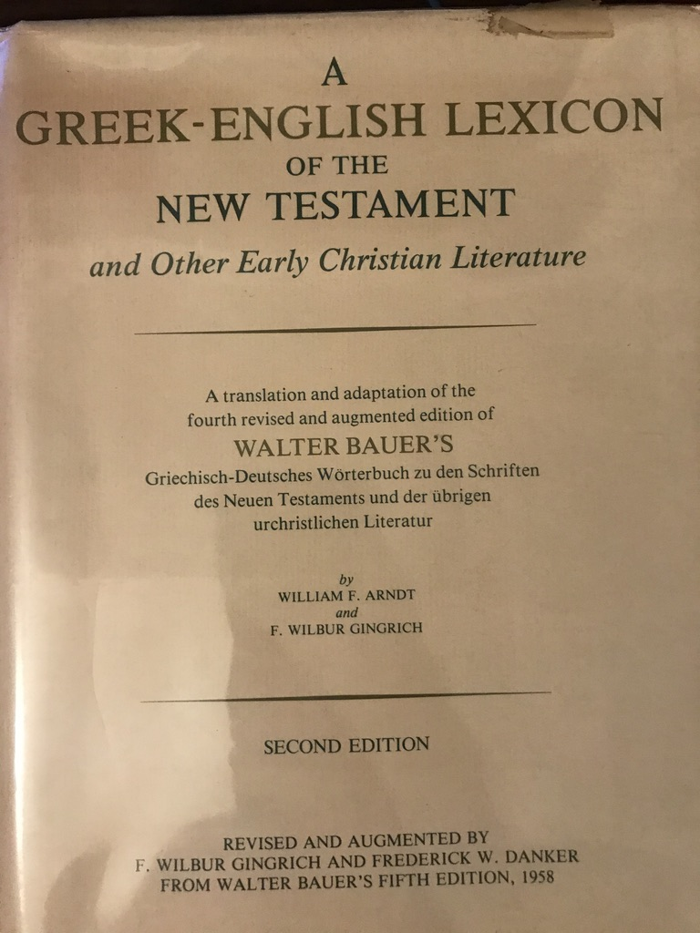
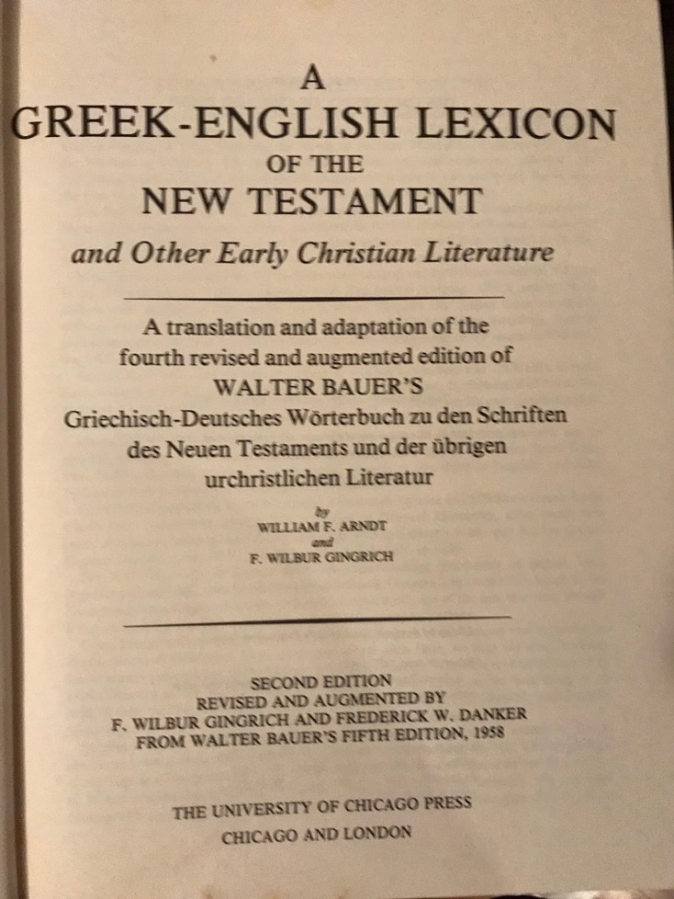

Slide 16
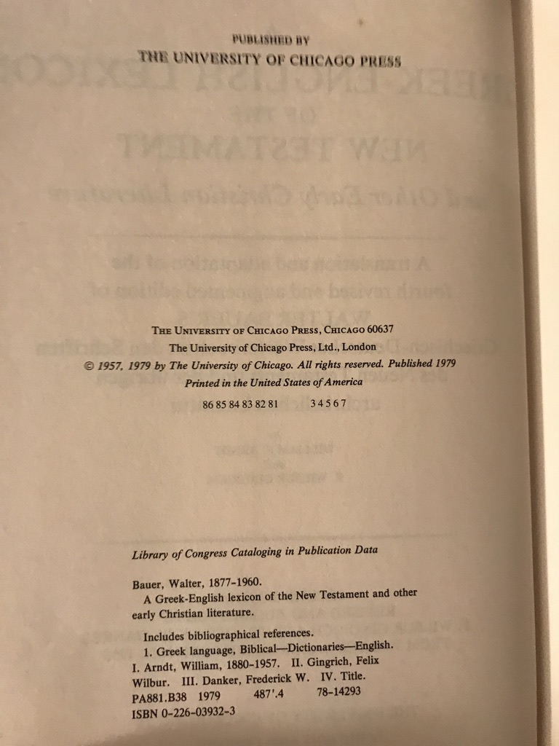
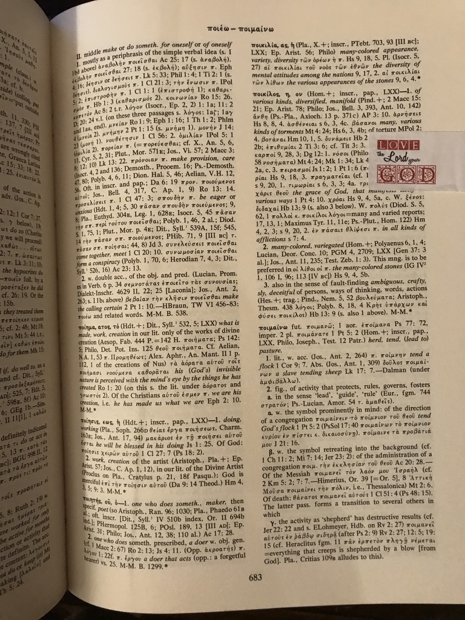

Slide 17
6: Hebrew Lexicon with BibleWorks Hebrew Font (WS 5.24)
¹ "rc;['," BDB 783.
⁵ BDB 783.
Brown, Francis, S. R. Driver and Charles A. Briggs. Hebrew and English Lexicon. Peabody, MA: Hendrickson, 1979.

Slide 18
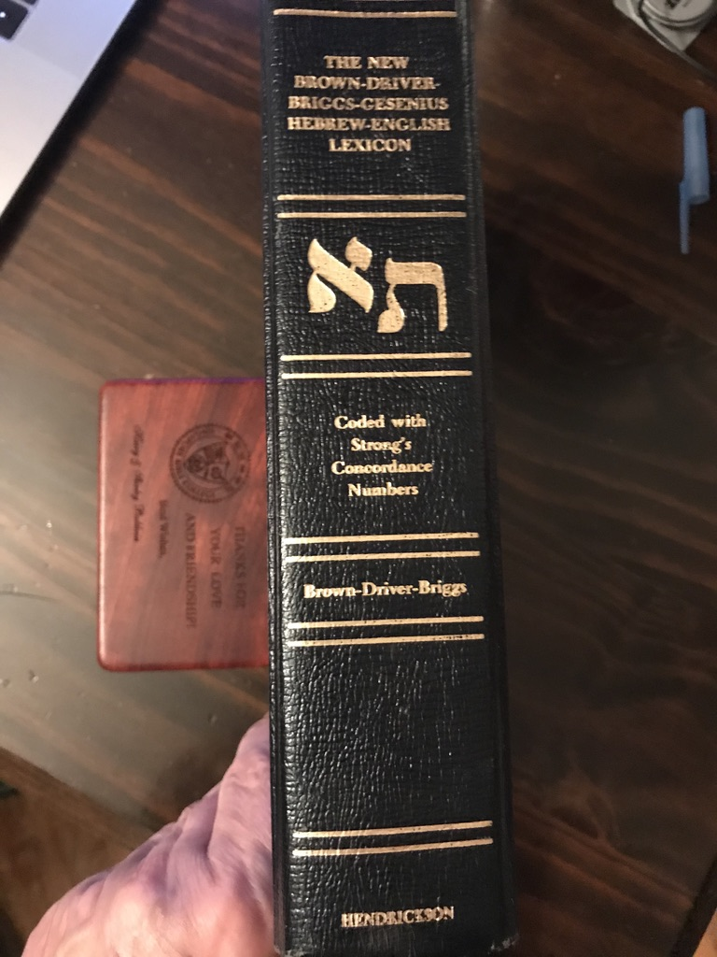
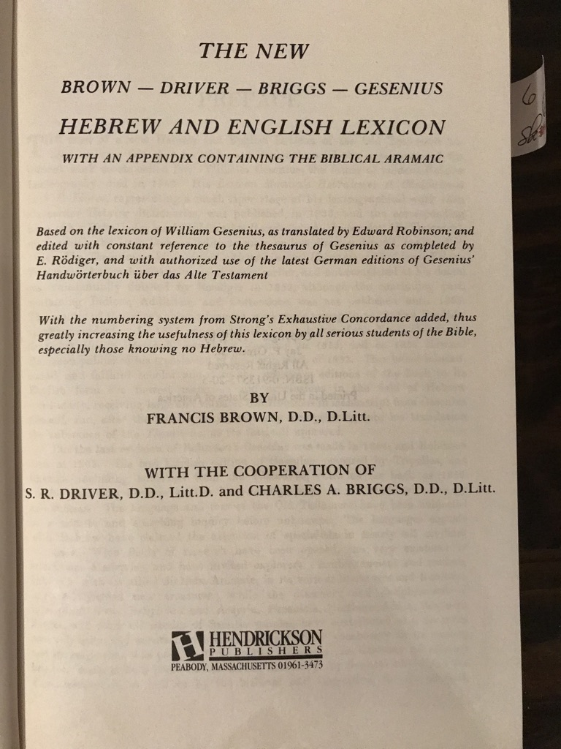

Slide 19
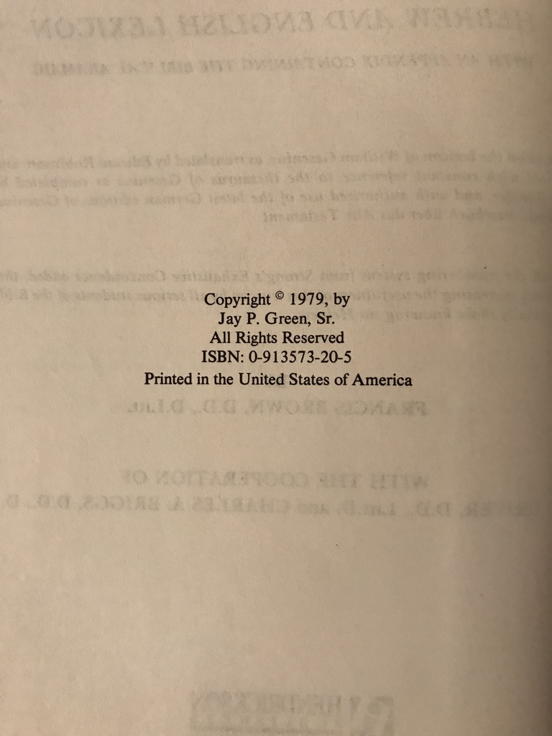
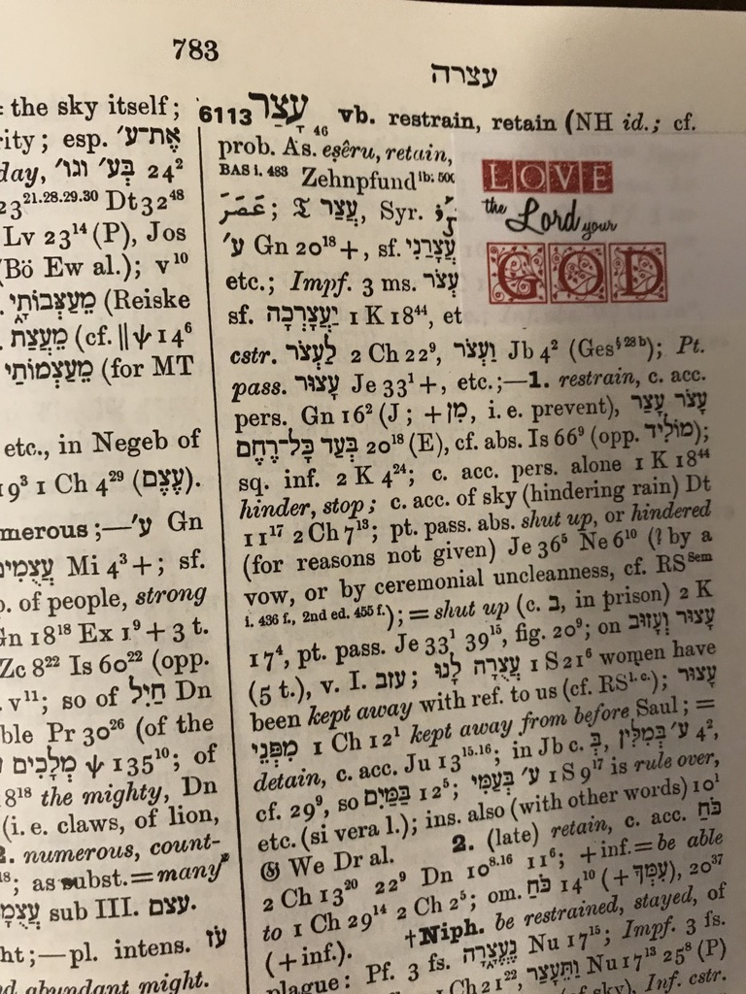

Slide 20
7: Journal Article with One Author (WS 5.13)
¹Sandra L. Glahn, “Weaker Vessels and Calling Husbands 'Lord': Was Peter Insulting Wives?” BS 174, no. 1 (2017): 73.
⁵Glahn, "Weaker Vessels and Calling Husbands 'Lord,'" 73.
Glahn, Sandra L. “Weaker Vessels and Calling Husbands 'Lord': Was Peter Insulting Wives?” Bibliotheca Sacra 174, no. 1 (2017): 73.

Slide 21
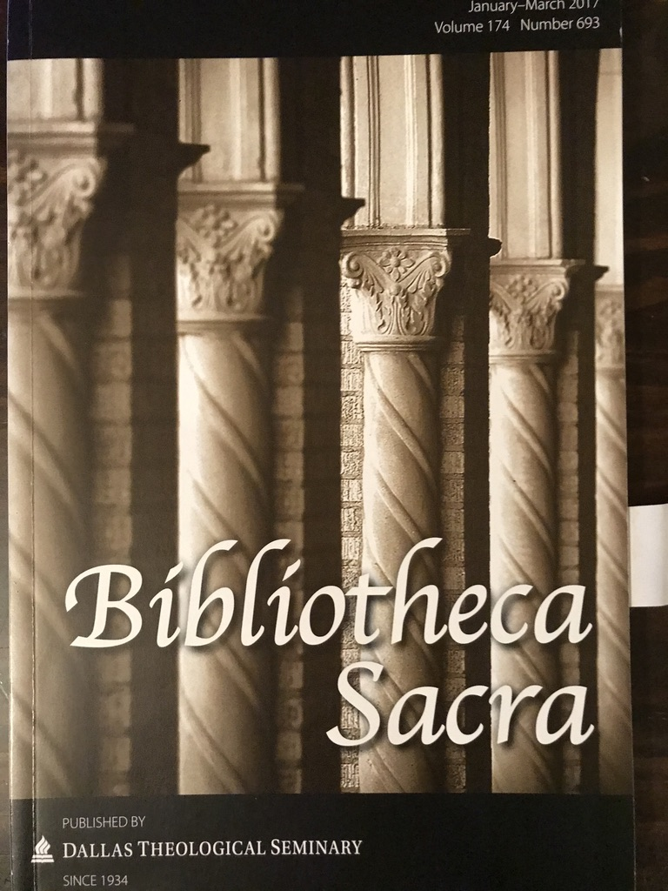
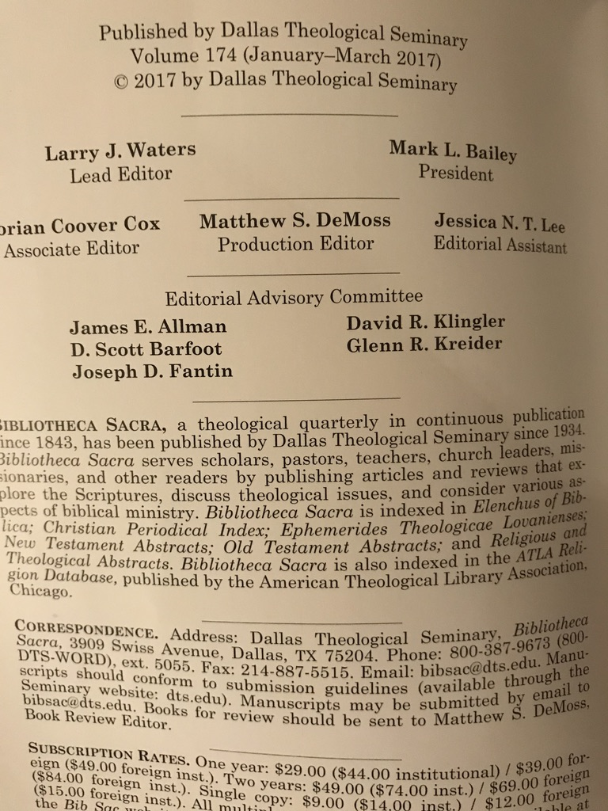

Slide 22
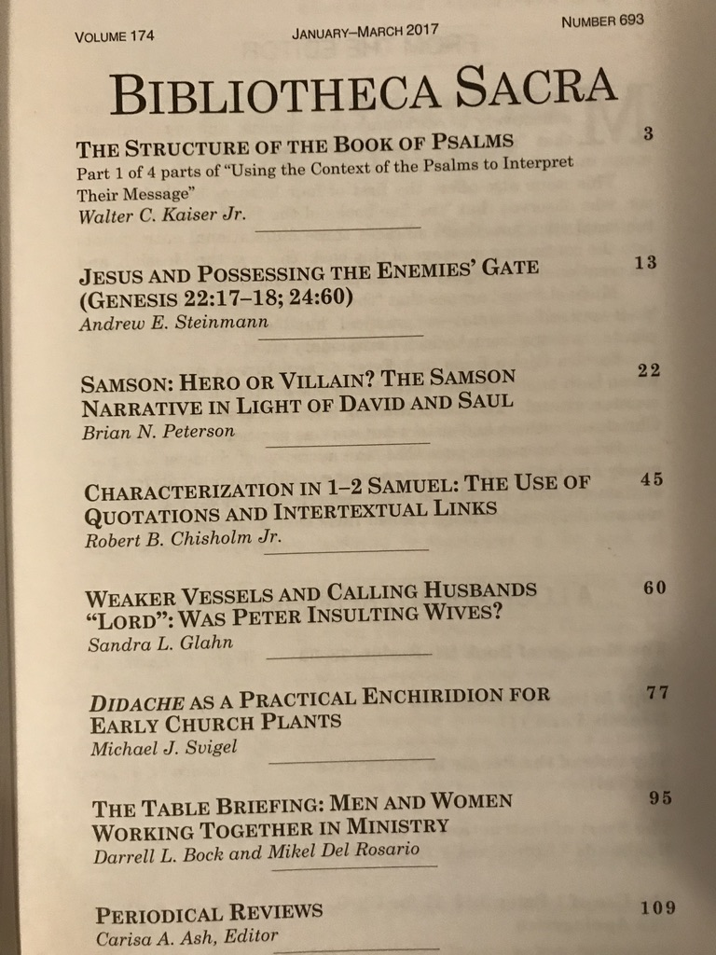
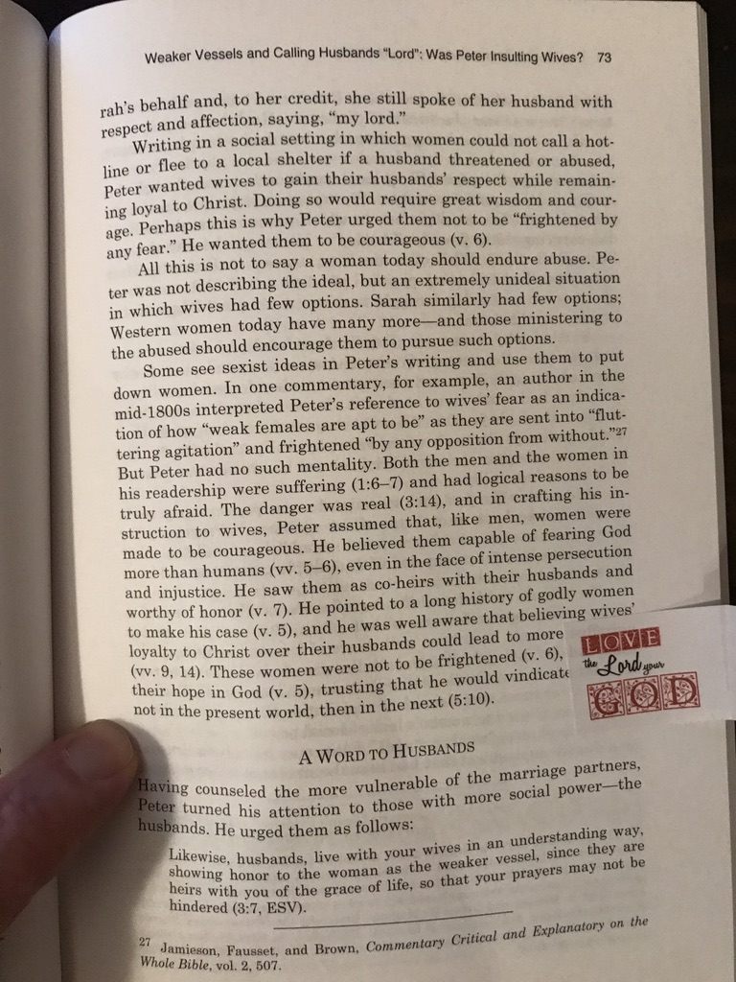

Slide 23
8: Journal Book Review (WS 5.22)
¹David A. Croteau, “Book Review on Galatians,” JETS 59, no. 2 (2016): 411.
⁵ Croteau, “Book Review on Galatians,” 411.
Croteau, David A. “Book Review on Galatians.” Journal of the Evangelical Theological Society 59 , no. 2 (2016): 411-13.

Slide 24
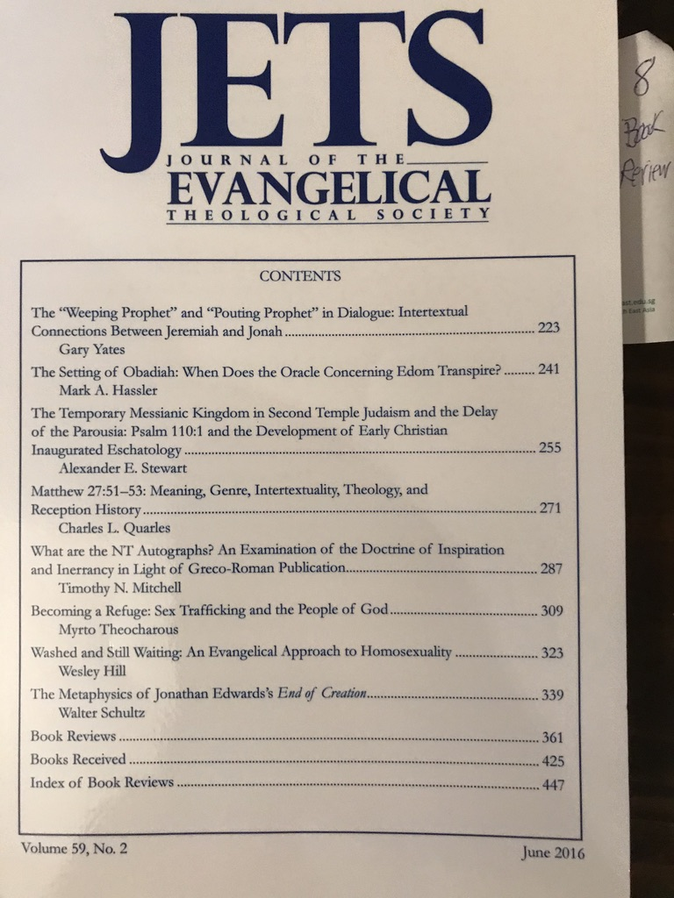
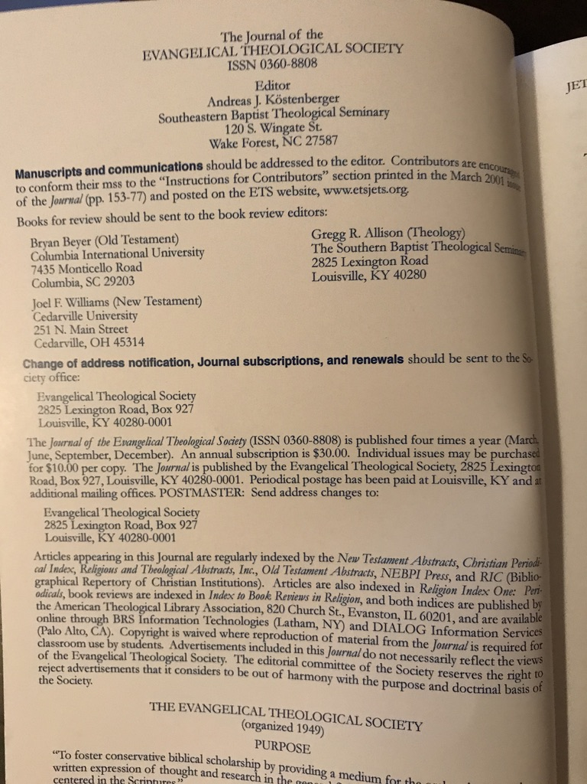

Slide 25
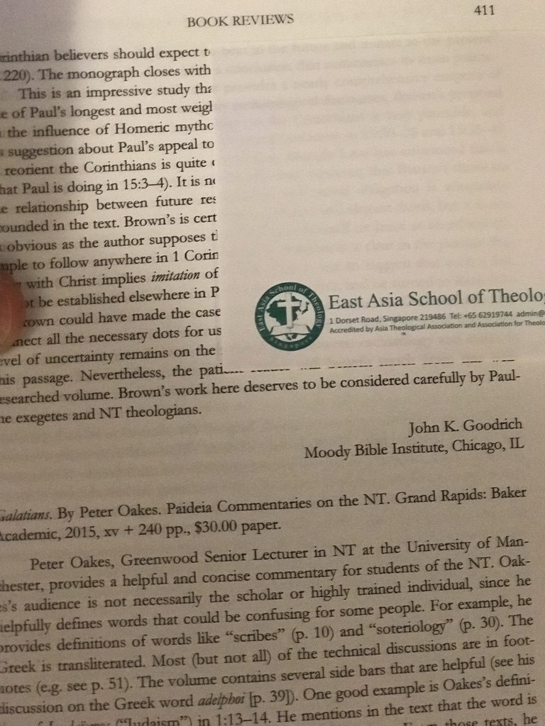
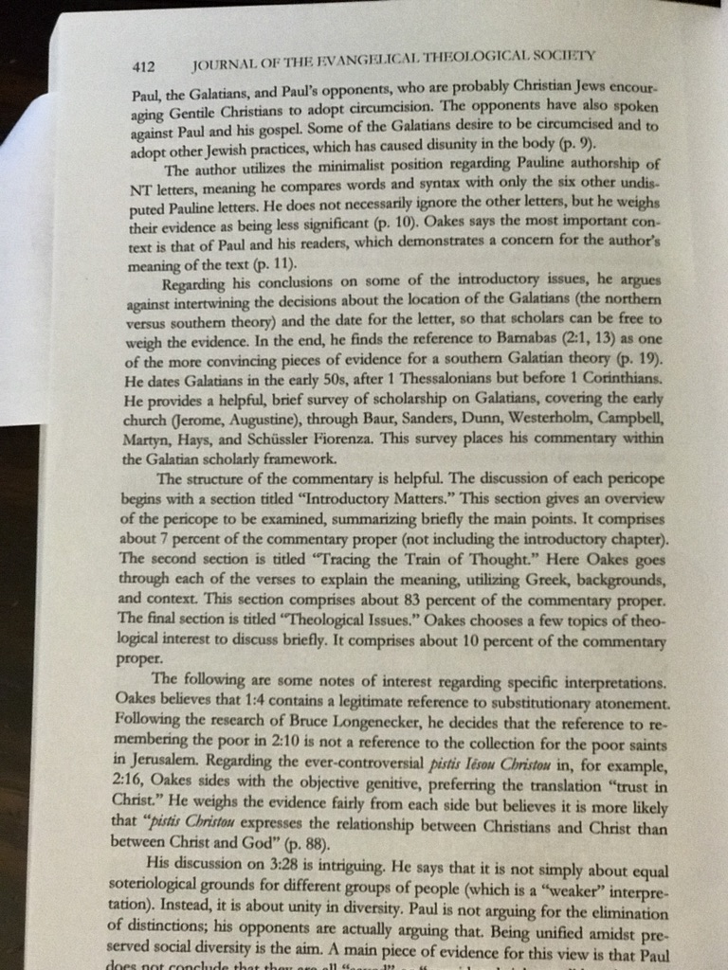

Slide 26
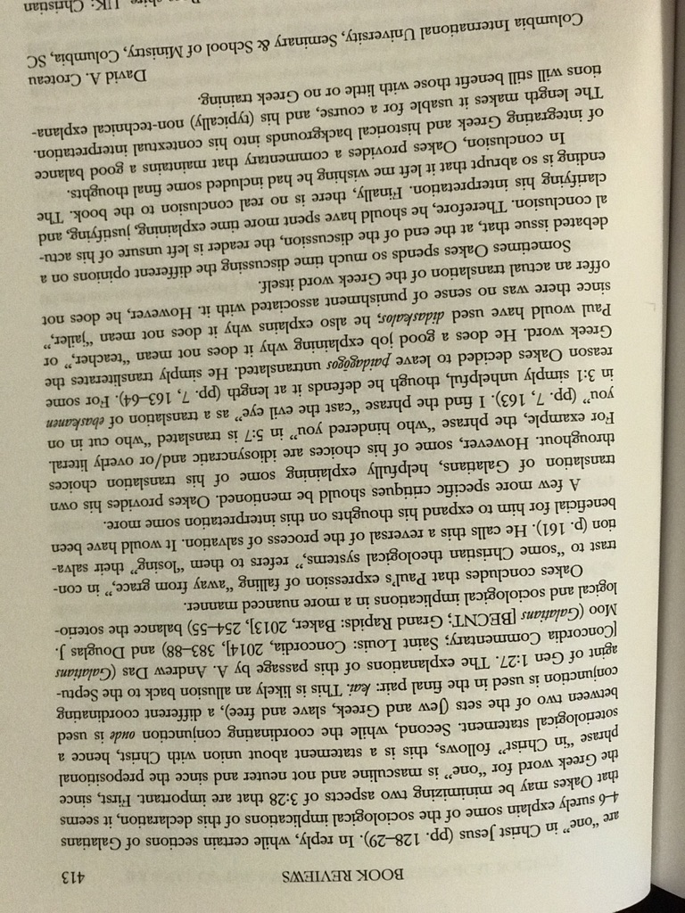

Slide 27
9: Website Text (WS 5.29)
¹Gordon Penfold, "Evangelism Bible Studies," Fresh Start Ministries, March 2007, http://www.startingfresh.net/11.html.
⁵Penfold, "Evangelism Bible Studies."
Penfold, Gordon. "Evangelism Bible Studies." Fresh Start Ministries. March 2007. http://www.startingfresh.net/11.html.
http://www.startingfresh.net/11.html

Slide 28
10: Website Download (WS 5.31)
¹Rick Griffith, "15-Ezra-138_eng_os_6510_v9.pptx"
(PowerPoint presentation, Singapore Bible College), http://www.biblestudydownloads.org/resource/old-testament-survey/ (accessed 27 April 2018), slide 15.
⁵Griffith, "Ezra," slide 15.
Griffith, Rick. "15-Ezra-138_eng_os_6510_v9.pptx." PowerPoint presentation at http://www.biblestudydownloads.org/resource/old-testament-survey/ (accessed 27 April 2018), slide 15.
http://www.biblestudydownloads.org/resource/old-testament-survey/
Ezra slide 15

